Slide 1
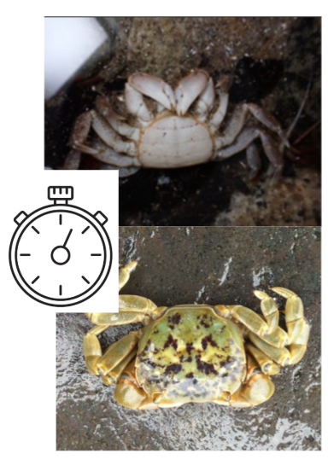

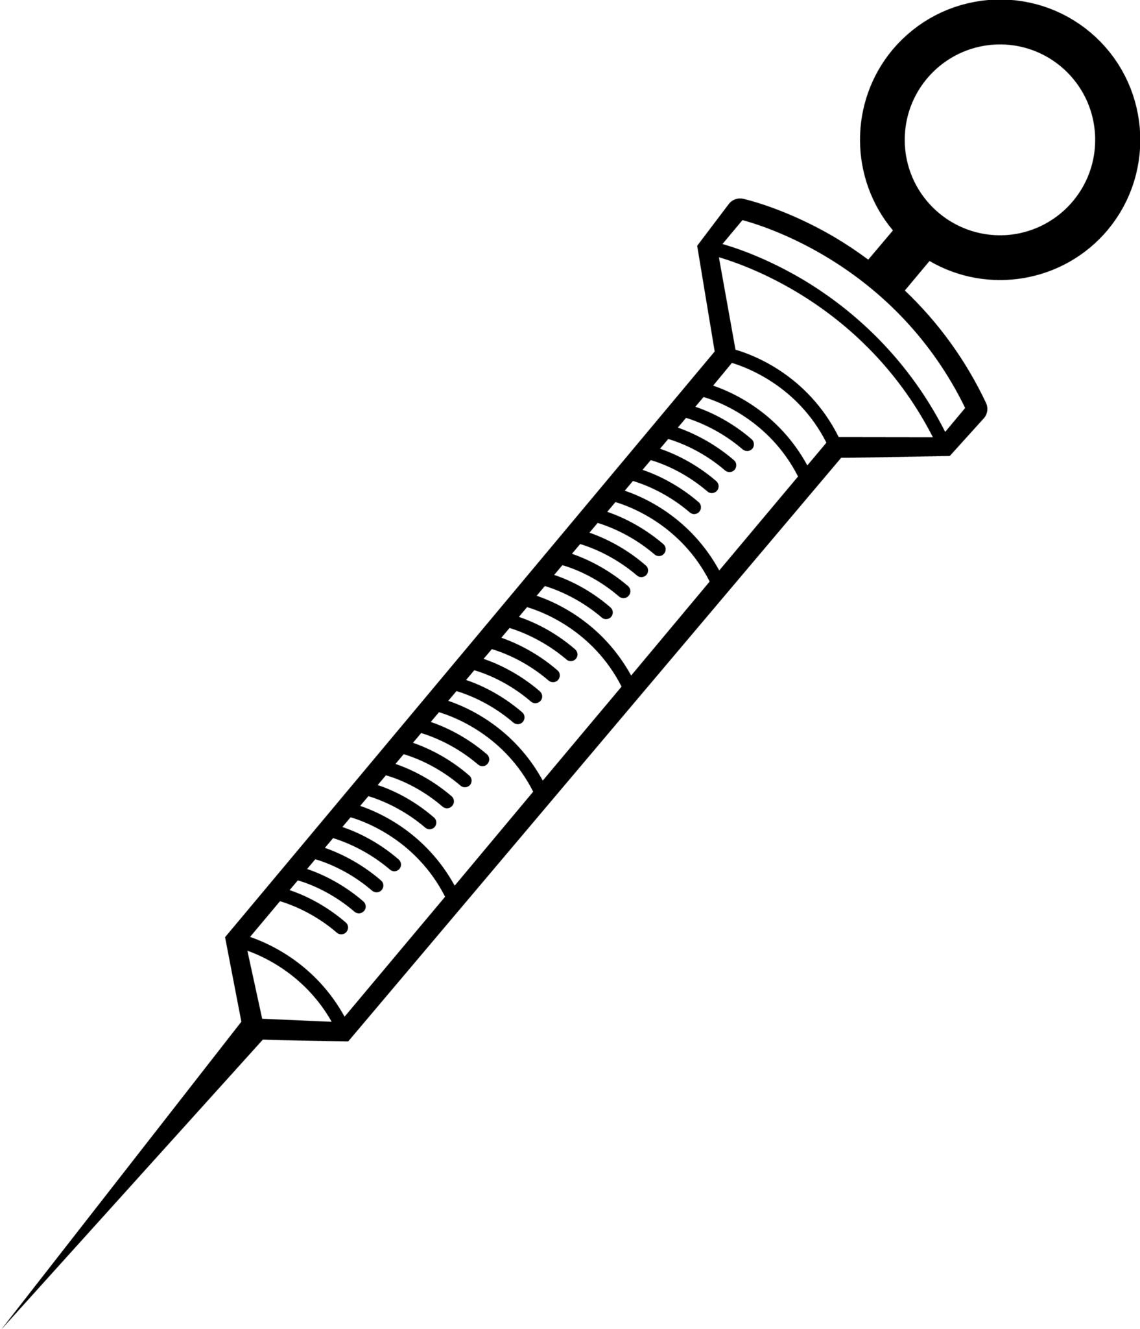
Marine Invertebrate Caffeine Exposure
Research question: How do different environmental concentrations (5ug/L, 10ug/L, and 15ug/L) of caffeine facilitate physiological stress responses in Hemigrapsus oregonensis?
Null hypothesis: Different environmental concentrations of caffeine will have no effect on the physiological stress response
Alternative hypothesis: Higher environmental concentrations of caffeine will have an increased effect on the physiological stress response
Measured amount of time it took crabs to right themselves after being placed upside down.
Weigh and place crabs in resazurin chamber and take a sample every 30 mins to record O2 consumption.
Hemolymph extracted from crabs and Lactate and BCA protein assays are run.

Slide 2
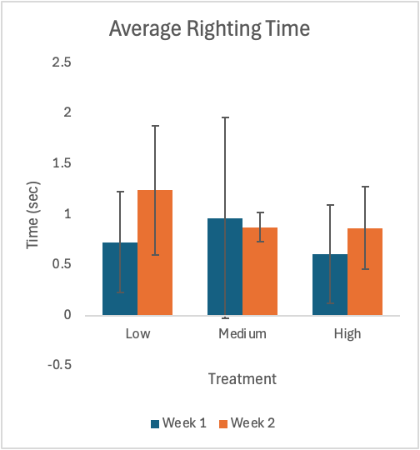
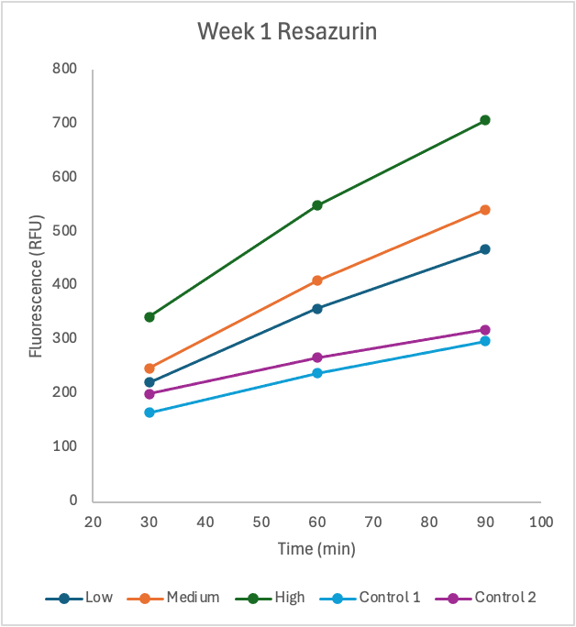
Hemolymph results haven’t yet been provided
Average the righting time from Week 1 and Week 2, comparing these values throughout different treatments.
Normalize based on weight, run linear regressions
Run ANOVA test comparing the average BCA and Lactate values across treatments

